Slide 1

Radius and TinyRadius
Dima Ionut Daniel

Slide 2
Contents
What is Radius?
Radius History
Radius Features
Radius Architecture
Radius Message Format
RADIUS and Security
RADIUS Support for PAP
RADIUS Support for CHAP
RADIUS Accounting
What is TinyRadius?
TinyRadius Features
TinyRadius Examples
Conclussion
Bibliography

Slide 3

What is Radius?
Remote Authentication Dial In User Service (RADIUS) is a networking protocol that provides centralized Authentication, Authorization, and Accounting (AAA) management for users that connect and use a network service.
RADIUS is a client/server protocol that runs in the application layer, using UDP as transport.
The RADIUS server is usually a background process running on a UNIX or Microsoft Windows server.
The base RADIUS specification was revised several times (RFCs 2058, 2138) and is now included in RFC 2865

Slide 4
Radius History
RADIUS was originally specified in an RFI by Merit Network in 1991 to control dial-in access to NSFnet.
RADIUS was later (1997) published as RFC 2058 and RFC 2059.
As of 2012, RADIUS can also use TCP as the transport layer with TLS for security.
Now, several commercial and open-source RADIUS servers exist.
Features can vary, but most can look up the users in text files, LDAP servers, various databases, etc.

Slide 5
Radius Features
RADIUS was originally designed to serve the purpose of allowing a NAS to forward a dial-up user’s request and its credentials to a backend server.
The base specification describes the process of authenticating a user to a server using PAP or CHAP, but does not describe support for accounting.
RADIUS was later extended to perform several other functions such as authentication using EAP.

Slide 6
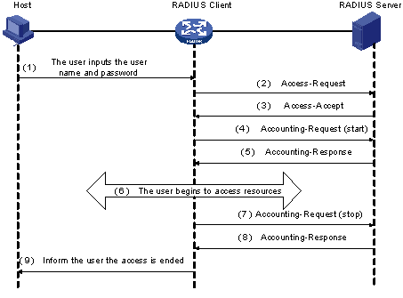
Radius Architecture
The messages exchanged between a RADIUS client and a RADIUS server are verified through a shared key.
The RADIUS protocol uses authentication and authorization processes by sending authorization information along with the authentication response message.

Slide 7
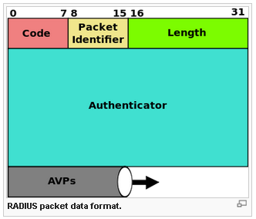
Radius Message Format
RADIUS packet format contains header, including code, ID, length and an authenticator field, followed by the payload, which is a list of zero or more attribute.
RADIUS messages are transported over UDPs.

Slide 8
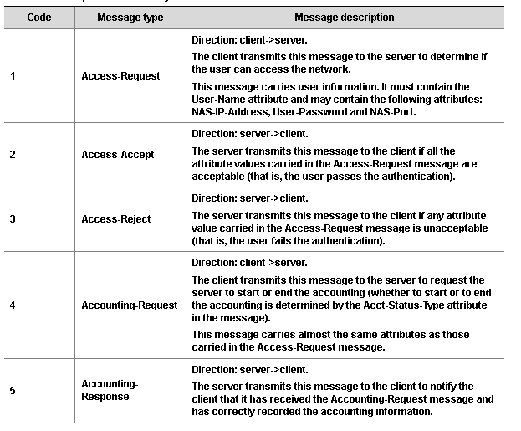
Radius Message Format (cont.)
The Code field (one byte) decides the type of RADIUS message.

Slide 9
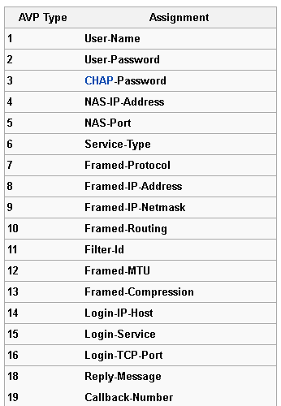
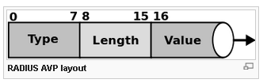
Radius Message Format (cont.)
The RADIUS Attribute Value Pairs (AVP) carry data in both the request and the response for the authentication, authorization, and accounting transactions.
The length of the radius packet is used to determine the end of the AVPs.
RADIUS is extensible; many vendors of RADIUS hardware and software implement their own variants using Vendor-Specific Attributes (VSAs).

Slide 10
RADIUS and Security
Security protection in RADIUS is rather primitive.
Two main functions are provided, one is attribute (mainly password) hiding and the other is authentication of certain messages.
Both these functions are performed using MD5 hash functions and a secret that is shared between the RADIUS server and the RADIUS client (NAS).
This secret is usually called the RADIUS shared secret.

Slide 11
RADIUS and Security (cont.)
In the Access Request message, the authenticator field is called the request authenticator, while in the Access Challenge, Accept and Reject messages are called the response authenticator.
In Access Request messages, the request authenticator value does not include any cryptographic secret.
Every time the client generates a new Access Request message with a new identifier it generates a new authenticator.
When protecting the Access Request message with the Message Authenticator, the client calculates a hash (MD5) over the entire message.
Message Authenticator value= MD5 (Code, ID, Length, Request Authenticator, Attributes).

Slide 12
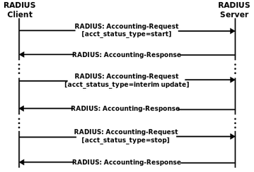
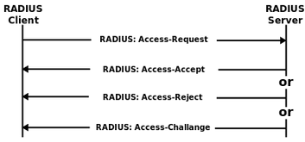
RADIUS and Security (cont.)
When receiving an Access Request message that includes this authenticator, the RADIUS server calculates the authenticator, using the shared secret and if there is not a match, the server discards the message.
Authenticator value=MD5 (Code, ID, Length, 16 zero octets, request attributes, shared secret).
In contrast to the Access Request message, the messages from the RADIUS server to the client (Access Challenge, Access Accept and Access Reject) receive better integrity protection.
Response Authenticator =MD5 (code, ID, Length, Request Authenticator,attributes, SS)

Slide 13
RADIUS Support for PAP
Password Authentication Protocol (PAP) the most proeminent way of performing user authentication.
During PAP authentication, if the server’s calculation of hash value fails, the server cannot tell whether the user password was wrong or the shared secret between the NAS and the RADIUS server was not correct.
Attributes sent along with the Access Request for PAP authentication:
User name: PAP ID for the user.
User password: The MD5 hash of SS, RA and user password.

Slide 14
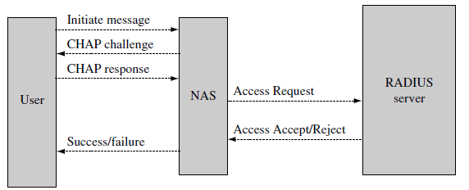
RADIUS Support for CHAP
CHAP(Challenge Handshake Authentication Protocol) is above PAP and avoids sending the password over the communication channel.
Attributes sent along with the Access Request for CHAP authentication:
User name: CHAP user name.
CHAP password: includes both CHAP ID and the CHAP response of the user to the challenge presented by server.
CHAP challenge: presented to the user.

Slide 15
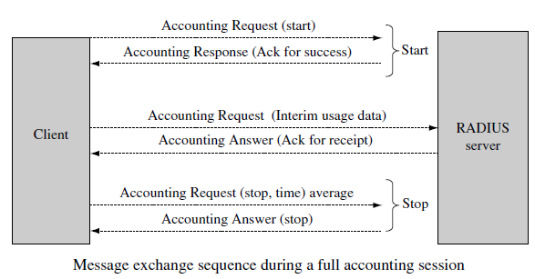
RADIUS Accounting
The RADIUS base standards document does not provide specifications for accounting support.
RADIUS accounting uses two messages types: Accounting Request and Accounting Response, both of which are also transported over UDP.
An NAS that is capable of supporting RADIUS accounting generates an Accounting Request “Start” at the start of operation and sends it to the RADIUS accounting server..
At the end of service delivery the client will generate an Accounting Stop packet.

Slide 16
What is TinyRadius?
TinyRadius is a simple, small and fast Java Radius library.
It’s capable of sending and receiving Radius packets of all types.
It’s released under the terms of the LGPL.

Slide 17
TinyRadius Features
TinyRadius features:
send and receive Radius packets (Access-Request, Access-Accept, Access-Reject, Access-Challenge, Accounting-Request, Accounting-Response and others) from within your Java application
use PAP and CHAP as authentication types for Access-Request messages
attach arbitrary Radius attributes to the packets employing attribute names read from a dictionary file
send and receive Radius packets with "Vendor-Specific" attributes

Slide 18
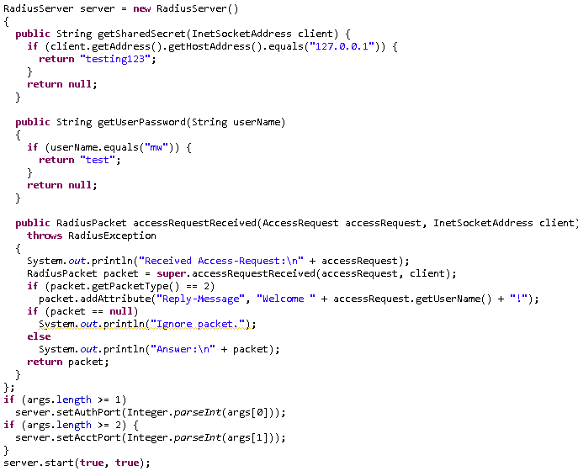
TinyRadius Examples
Bellow it’s an example for creating Radius Server with PAP authentication.

Slide 19
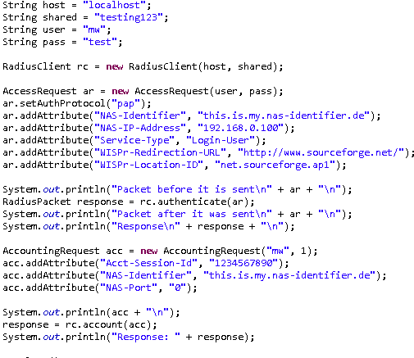
TinyRadius Examples (cont.)
Bellow it’s an example for creating Radius Client that uses PAP authentication.

Slide 20
Conclussion
Remote Authentication Dial-In User Service (RADIUS) is a client/server protocol used for AAA.
TinyRadius it’s very easy to use.
TinyRadius is documented and has a Java API.

Slide 21

Bibliography
http://en.wikipedia.org/wiki/RADIUS
http://tinyradius.sourceforge.net/
Charging for Mobile All-IP Telecommunications
Wiley AAA and Network Security for Mobile Access Radius Diameter EAP PKI and IP Mobility

Slide 22
Questions ?

